Slide 1


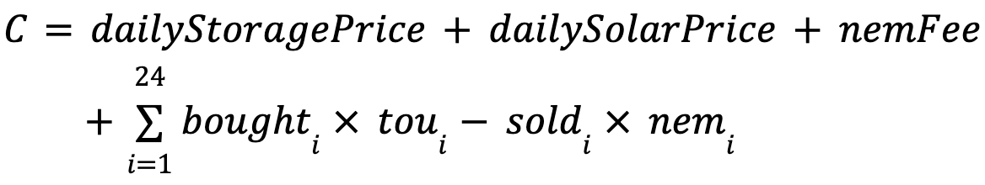
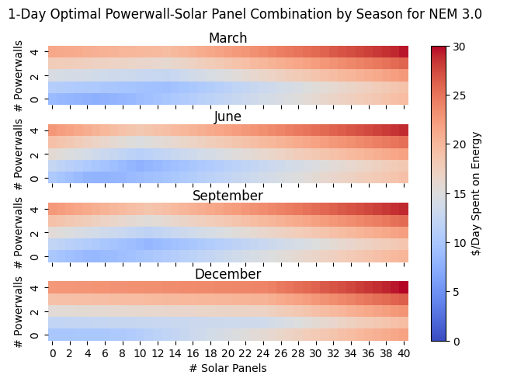
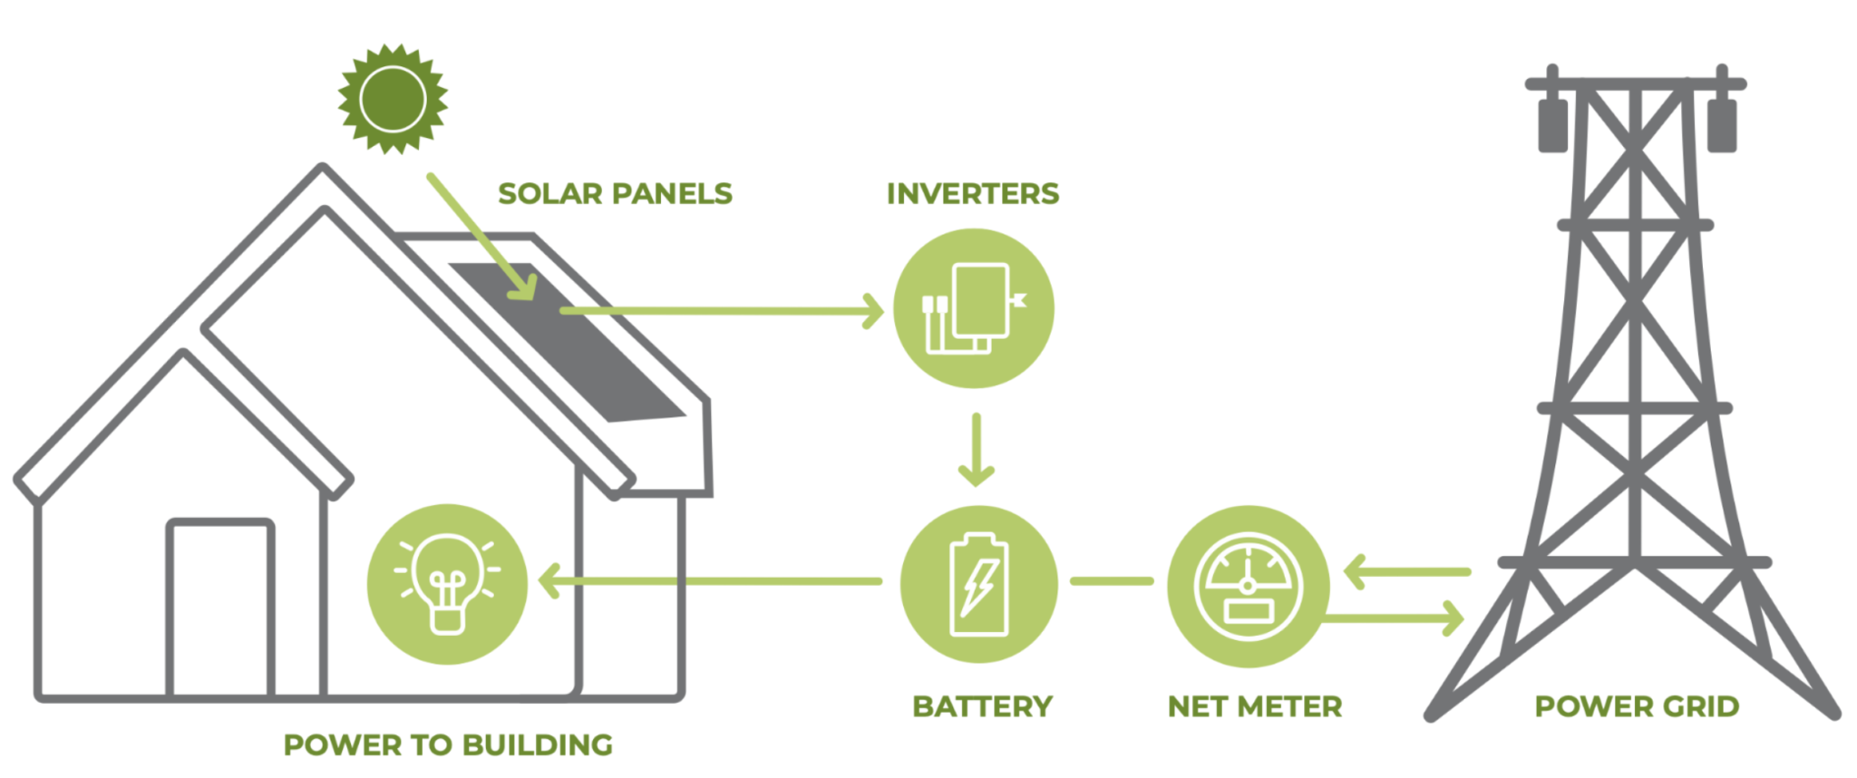
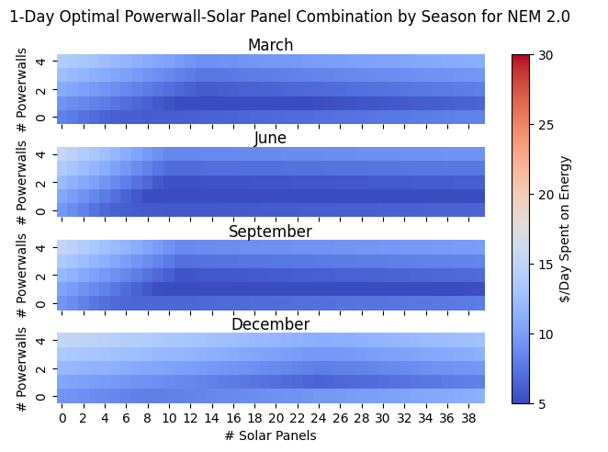
NEM 2.0 vs 3.0: Optimal Battery and Solar Installation Sizes
Koye Alagbe¹ and Jenna Ruzekowicz²
¹ Computer Science, Stanford University
² Civil and Environmental Engineering, Stanford University
CEE 272R
Abstract
Method
Results NEM 3.0
In California, Net Energy Metering (NEM) provides monetary incentives to owners of rooftop solar by allowing customers to sell excess energy they generate back to the grid. Although this lowers the customers’ energy costs, the price of installing solar panels and batteries can negate some of the economic benefits of net metering, especially for larger battery systems or PV arrays. For this reason, customers must choose the sizes of solar and battery installations that minimize total costs over a set payback period. In this project, we use convex optimization to find optimal sizes for PV systems under California’s NEM 2.0 and NEM 3.0 policies. NEM 2.0 is a promised 20-year payback period and locks users into 20 years of the NEM 2.0 rates. NEM 3.0 is currently marketed as a 9-year payback period and thus locks users into excess energy selling prices for a much shorter time. We calculate optimal battery and solar array sizes for a typical Palo Alto household using real load and irradiance data for an average day in June, September, December, and March, comparing the optimal values across both NEM contracts.
Net total cost is defined as:
where bought and sold are the amounts of energy bought or sold to the grid every hour, and tou and nem are rate vectors
Our objective was to minimize this value subject to constraints on battery state of charge, charge/discharge rates, and energy conservation across the system
Month | # Powerwalls | # Solar Panels | Energy Price ($/Day)
March | 0 | 5 | 7.58
June | 1 | 10 | 7.83
September | 1 | 11 | 8.24
December | 0 | 0 | 9.99
Results NEM 2.0
Month | # Powerwalls | # Solar Panels | Energy Price ($/Day)
March | 1 | 13 | 4.31
June | 1 | 10 | 3.72
September | 1 | 11 | 3.93
December | 1 | 24 | 6.37
Background
NEM introduced in California in 1996
Fees and lower buy-back rates introduced between NEM 1.0, 2.0, and 3.0 to make it more affordable for the government [3, 4]
[1]
Conclusion/Next Steps
Data
We have seen that with optimal solar and battery installations, NEM customers can save on energy costs
In the future, we would like to investigate the adverse effects that this might have on other community members who cannot afford PV installations
24-hour average hourly demand curve for households in California generated from PG&E data [9]
Average hourly irradiance obtained from the NREL Solar Radiation Database [8]
Battery specifications based on Tesla Powerwall 3 [6]
Solar panel specifications based on SunPower panel model [7]
TOU electricity prices obtained from PG&E’s E-ELEC and E-TOU-C [4, 2]
References
[1] "An Overview of Net Metering: Attacks Coming Closer to the DMV," IPSUN Solar, [Online]. Available: https://ipsunsolar.com/blog/an-overview-of-net-metering-attacks-coming-closer-to-the-dmv/. [Accessed: June 2, 2024].
[2] "Residential Electric Rate Plan Pricing," Pacific Gas and Electric Company, [Online]. Available: https://www.pge.com/assets/pge/docs/account/rate-plans/residential-electric-rate-plan-pricing.pdf. [Accessed: June 2, 2024].
[3] "Net Energy Metering 2.0 Fact Sheet," Modesto Irrigation District, [Online]. Available: https://www.mid.org/forms/NetEnergyMetering2.0FactSheet.pdf. [Accessed: June 2, 2024].
[4] "Electric Schedules E - Electric Rules and Regulations - Distribution of Electric Service," Pacific Gas and Electric Company, [Online]. Available: https://www.pge.com/tariffs/assets/pdf/tariffbook/ELEC_SCHEDS_E-ELEC.pdf. [Accessed: June 2, 2024].
[5] "Residential Electric Rate Plan Pricing," Pacific Gas and Electric Company, [Online]. Available: https://www.pge.com/assets/pge/docs/account/rate-plans/residential-electric-rate-plan-pricing.pdf. [Accessed: June 2, 2024].
[6] "Powerwall 3 with Gateway 3 Installation Manual NA-EN," Tesla, [Online]. Available: https://service.tesla.com/docs/Public/Energy/Powerwall/Powerwall-3-with-Gateway-3-Installation-Manual-NA-EN/GUID-EC527BC7-4750-4425-BBC4-DB8C000339B3.html. [Accessed: June 2, 2024].
[7] "SunPower X21 345 COM Data Sheet," ProVision Solar, [Online]. Available: https://provisionsolar.com/wp-content/uploads/2014/12/SunPower-X21-345-COM-Data-Sheet.pdf. [Accessed: June 2, 2024].
[8] "National Solar Radiation Database," National Renewable Energy Laboratory, [Online]. Available: https://nsrdb.nrel.gov/. [Accessed: June 2, 2024].
[9] "PG&E Energy Data Request," Pacific Gas and Electric Company, [Online]. Available: https://pge-energydatarequest.com/. [Accessed: June 2, 2024].

